Slide 1

UNIT 1: What’s happening?

Slide 2
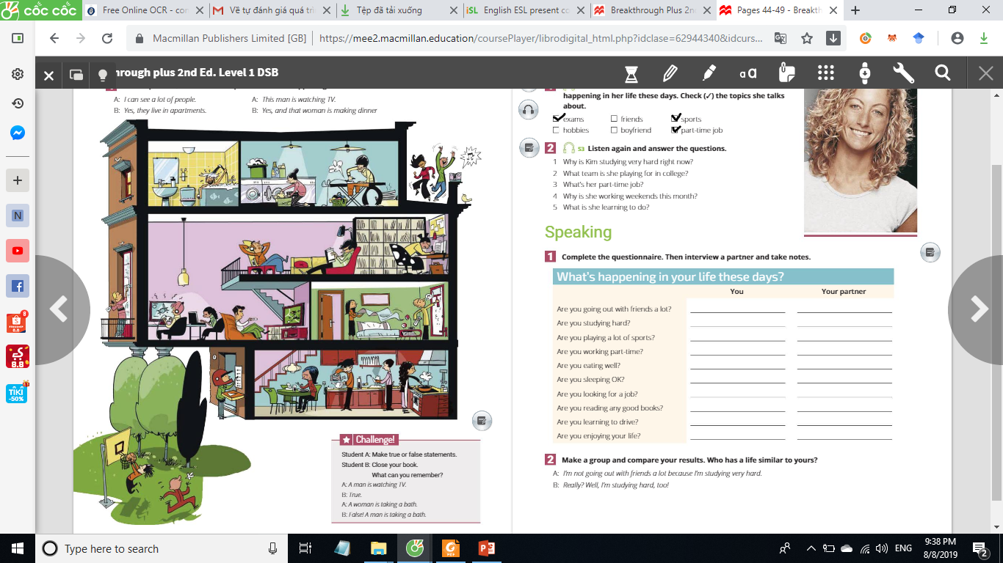

01
In your words

Slide 3

01
In your words
Look at the picture and tell your partner what is happening in it

Slide 4
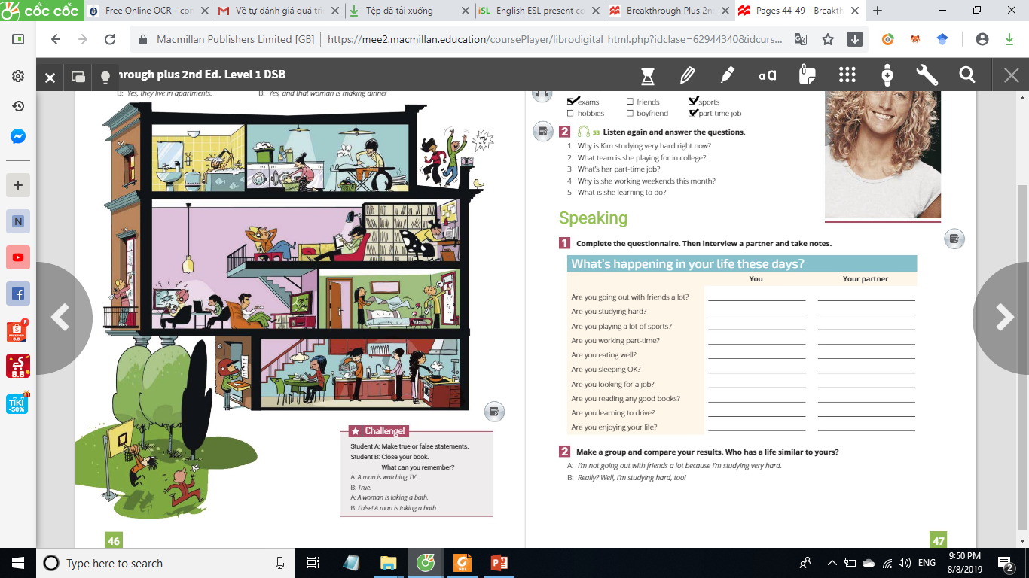
01
In your words

Slide 5
01
In your words

Slide 6
01
In your words

Slide 7
01
In your words

